Slide 1
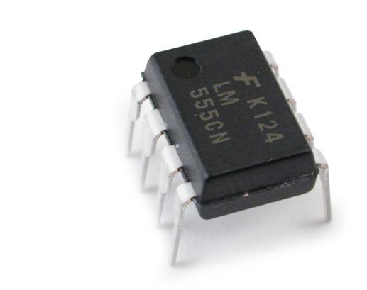
555 Timer IC
Working of 555 IC

Slide 2
Contents
Introduction to 555 Timer IC
555 Timer IC Pin Diagram
Basics of 555 TImer
Block Diagram
Working Principle

Slide 3
Introduction to 555 Timer IC
Introduced in the year 1970 by Signetic Corporation
Named as SE/NE 555 timer
A monolithic timing circuit that produces accurate and highly stable time delays or oscillation

Slide 4
Important Features of 555 Timer
It operates from a wide range of power supplies ranging from + 5 Volts to + 18 Volts supply voltage.
Sinking or sourcing 200 mA of load current.
The external components should be selected properly so that the timing intervals can be made into several minutes along with the frequencies exceeding several hundred kilohertz.
The output of a 555 timer can drive a transistor-transistor logic (TTL) due to its high current output.
It has a temperature stability of 50 parts per million (ppm) per degree Celsius change in temperature, or equivalently 0.005 %/ °C.
The duty cycle of the timer is adjustable.
The maximum power dissipation per package is 600 mW and its trigger and reset inputs has logic compatibility. More features are listed in the datasheet.

Slide 5
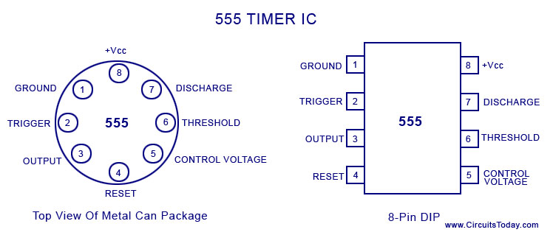
IC Pin Configuration

Slide 6

IC Pin Configuration
Pin 1: Grounded Terminal: All the voltages are measured with respect to the Ground terminal.
Pin 2: Trigger Terminal: The trigger pin is used to feed the trigger input hen the 555 IC is set up as a monostable multivibrator. This pin is an inverting input of a comparator and is responsible for the transition of flip-flop from set to reset. The output of the timer depends on the amplitude of the external trigger pulse applied to this pin. A negative pulse with a dc level greater than Vcc/3 is applied to this terminal. In the negative edge, as the trigger passes through Vcc/3, the output of the lower comparator becomes high and the complimentary of Q becomes zero. Thus the 555 IC output gets a high voltage, and thus a quasi-stable state.
Pin 3: Output Terminal: Output of the timer is avail­able at this pin. There are two ways in which a load can be connected to the output terminal. One way is to connect between output pin (pin 3) and ground pin (pin 1) or between pin 3 and supply pin (pin 8). The load connected between output and ground supply pin is called the normally on load and that connected between output and ground pin is called the normally off load.
Pin 4: Reset Terminal: Whenever the timer IC is to be reset or disabled, a negative pulse is applied to pin 4, and thus is named as reset terminal. The output is reset irrespective of the input condition. When this pin is not to be used for reset purpose, it should be connected to + V_{CC} to avoid any possibility of false triggering.

Slide 7
IC Pin Configuration
Pin 5: Control Voltage Terminal: The threshold and trigger levels are controlled using this pin. The pulse width of the output waveform is determined by connecting a POT or bringing in an external voltage to this pin. The external voltage applied to this pin can also be used to modulate the output waveform. Thus, the amount of voltage applied in this terminal will decide when the comparator is to be switched, and thus changes the pulse width of the output. When this pin is not used, it should be bypassed to ground through a 0.01 micro Farad to avoid any noise problem.
Pin 6: Threshold Terminal: This is the non-inverting input terminal of comparator 1, which compares the voltage applied to the terminal with a reference voltage of 2/3 V_{CC}. The amplitude of voltage applied to this terminal is responsible for the set state of flip-flop. When the voltage applied in this terminal is greater than 2/3Vcc, the upper comparator switches to +Vsat and the output gets reset.
Pin 7 : Discharge Terminal: This pin is connected internally to the collector of transistor and mostly a capacitor is connected between this terminal and ground. It is called discharge terminal because when transistor saturates, capacitor discharges through the transistor. When the transistor is cut-off, the capacitor charges at a rate determined by the external resistor and capacitor.
Pin 8: Supply Terminal: A supply voltage of + 5 V to + 18 V is applied to this terminal with respect to ground (pin 1).

Slide 8
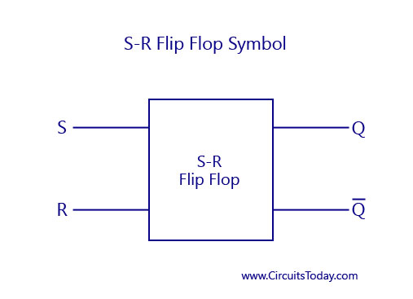
Timer Basics

Slide 9
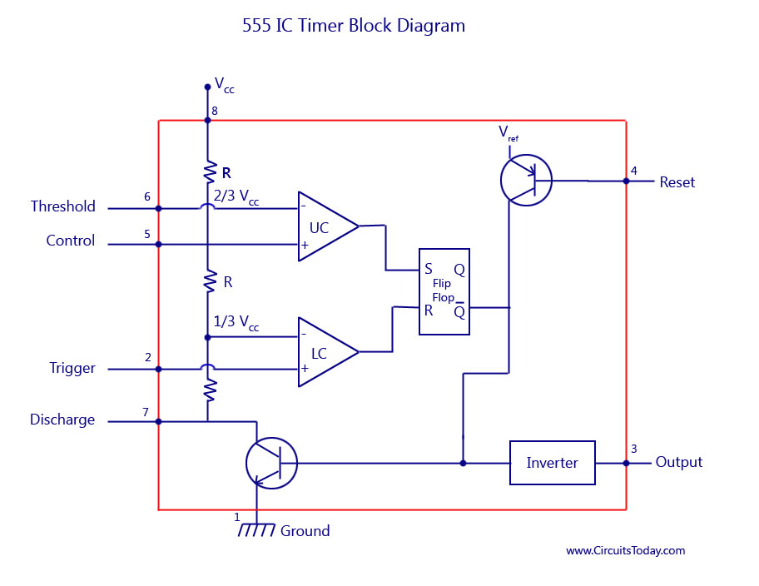
555 IC Timer Block Diagram
Notes:
Resistive network consists of three equal resistors and acts as a voltage divider.
Comparator 1 compares threshold voltage with a reference voltage + 2/3 V_{CC} volts.
Comparator 2 compares the trigger voltage with a reference voltage + 1/3 V_{CC} volts.

Slide 10
Working Principle
The internal resistors act as a voltage divider network, providing (2/3)Vcc at the non-inverting terminal of the upper comparator and (1/3)Vcc at the inverting terminal of the lower comparator.
In most applications, the control input is not used, so that the control voltage equals +(2/3) V_{CC}.
Upper comparator has a threshold input (pin 6) and a control input (pin 5).
Output of the upper comparator is applied to set (S) input of the flip-flop. Whenever the threshold voltage exceeds the control voltage, the upper comparator will set the flip-flop and its output is high.
A high output from the flip-flop when given to the base of the discharge transistor saturates it and thus discharges the transistor that is connected externally to the discharge pin 7.
The complementary signal out of the flip-flop goes to pin 3, the output. The output available at pin 3 is low.
These conditions will prevail until lower comparator triggers the flip-flop.
Even if the voltage at the threshold input falls below (2/3) V_{CC}, that is upper comparator cannot cause the flip-flop to change again.
It means that the upper comparator can only force the flip-flop’s output high.

Slide 11
Working Principle
To change the output of flip-flop to low, the voltage at the trigger input must fall below + (1/3) Vcc. When this occurs, lower comparator triggers the flip-flop, forcing its output low. The low output from the flip-flop turns the discharge transistor off and forces the power amplifier to output a high. These conditions will continue independent of the voltage on the trigger input. Lower comparator can only cause the flip-flop to output low.
From the above discussion, it is concluded that for the having low output from the timer 555, the voltage on the threshold input must exceed the control voltage or + (2/3) V_{CC}. This also turns the discharge transistor on. To force the output from the timer high, the voltage on the trigger input must drop below +(1/3) V_{CC}. This turns the discharge transistor off.
A voltage may be applied to the control input to change the levels at which the switching occurs. When not in use, a 0.01 nano Farad capacitor should be connected between pin 5 and ground to prevent noise coupled onto this pin from causing false triggering.
Connecting the reset (pin 4) to a logic low will place a high on the output of flip-flop. The discharge transistor will go on and the power amplifier will output a low. This condition will continue until reset is taken high. This allows the synchronization or resetting of the circuit’s operation. When not in use, reset should be tied to +V_{CC}.

Slide 12
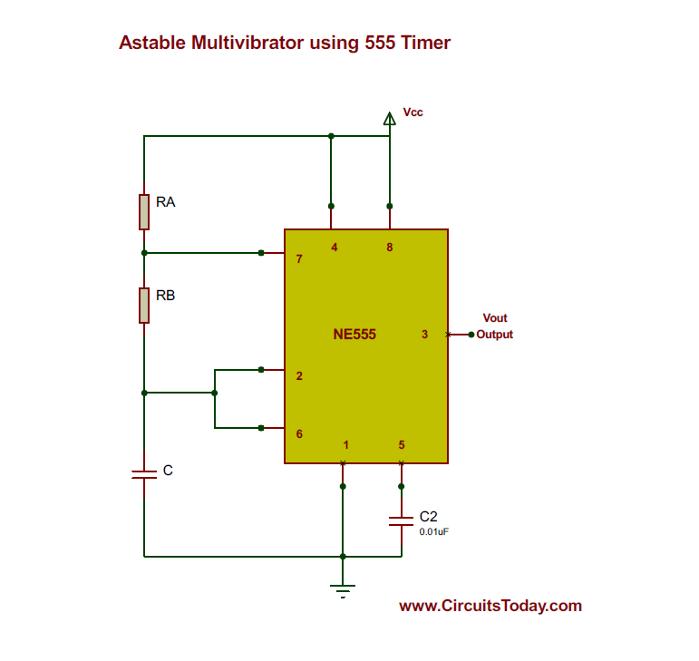
555 Timer as Astable Multivibrator

Slide 13
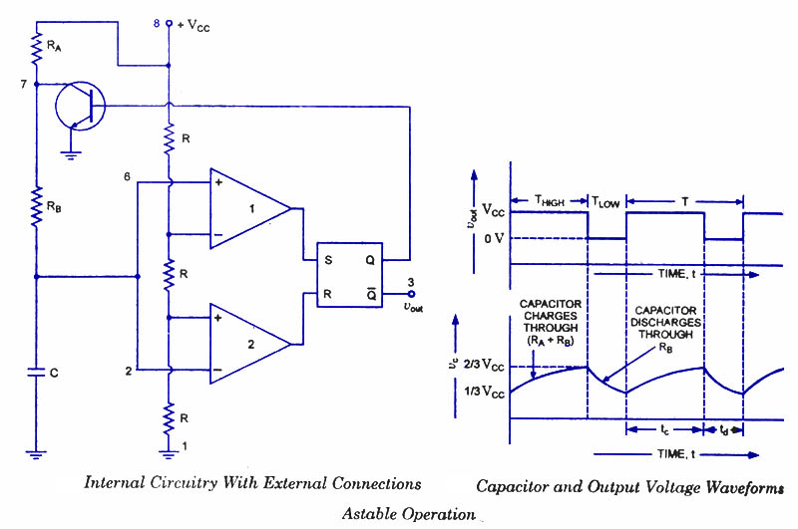
Astable Multivibrator Working

Slide 14
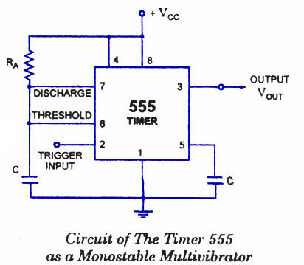
555 Timer as Monostable Multivibrator

Slide 15
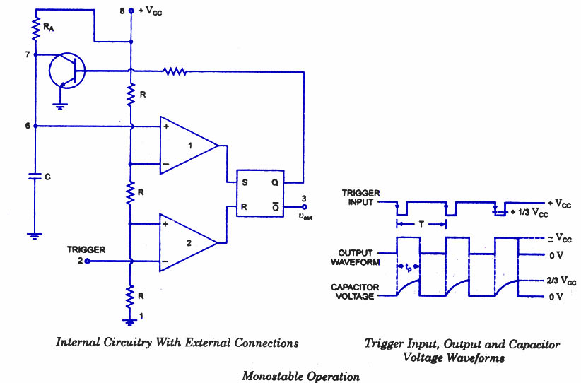
Monostable Multivibrator Working

